Slide 1





DEPARTMENT OF COMPUTER SCIENCE & ENGINEERING
Convolutional Neural Networks for Handwritten Text Conversion
Guide :
Ms.Soja Rani,
Sr.Assistant Professor,
Dept. of CSE,
NHCE, Bangalore
By :
Mohan Krishna B(1NH14CS071)
Swathi Madhavan(1NH14CS732)
Prakash H (1NH14CS167)
Rahul N (1NH14CS098)

Slide 2
Agenda
The objective is to convert the handwritten document into digital document consisting of ASCII characters which can be easily read or manipulated on any electronic device.

Slide 3
Abstract
R-CNN (Regional Convolutional Neural Network) is used for conversion. It is the pre-eminent machine learning visual object detection algorithm.
The input document image is pre-processed using adaptive thresholding in order to remove noise and artifacts in the image.
Character segmentation is performed to obtain individual characters from the image along with their positions.
These characters are passed individually into the Convolutional Neural Network (CNN) model which produces the probability of each character class.
The character with the highest class probability is chosen as the output character and is written into the text document based on its corresponding position.

Slide 4
Existing System
Optical Character Recognition (OCR) recognizes typed characters on paper rather than handwritten characters.
Another system called LeNet performs handwritten digit conversion using CNN and MNIST dataset.
Most systems use non-machine learning algorithms to perform conversion in programmatic approach which are highly inefficient.

Slide 5
Advantages and Disadvantages of Existing Systems
Advantages:
Better performance in character recognition.
Disadvantages:
A character never gets a probability of 1.
Recognizing both handwritten letters and digits are not implemented using machine learning algorithms at a document-level.
Post processing of the output is not performed.
Programmatic approach is highly inefficient since it cannot detect most of the handwritten characters.

Slide 6
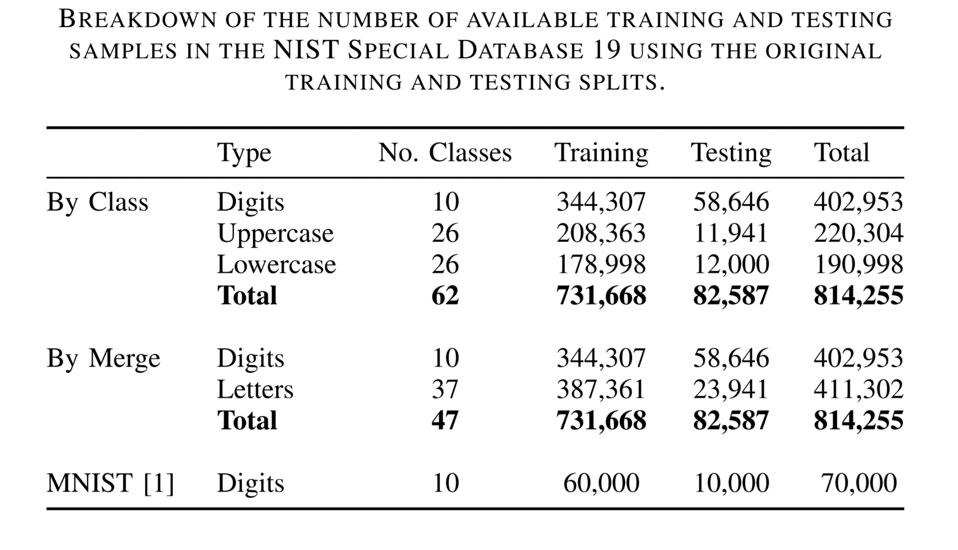
EMNIST Dataset

Slide 7
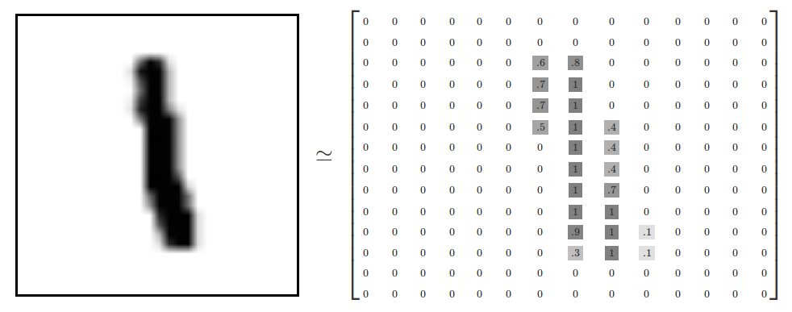
How are characters represented in the Dataset?

Slide 8
Proposed System
The conversion uses Regional Convolutional Neural Network (R-CNN) for object detection.
The input image is pre-processed to remove noise and artifacts.
The processed characters are segmented to retrieve individual characters, which are then passed into the Convolutional Neural Network (CNN) for the prediction of the output character.

Slide 9
Advantages and Disadvantages of Proposed System
Advantages:
Pre-processing of the image for efficient conversion.
Document level conversion is performed for both handwritten letters and digits.
A character may get a probability of 1.
Machine learning allows the system to be flexible for varied inputs.
Disadvantages:
Requires a large training time.

Slide 10
Algorithm / Methodology
Regional - Convolutional Neural Network (R-CNN)
Convolutional Neural Network (CNN)

Slide 11
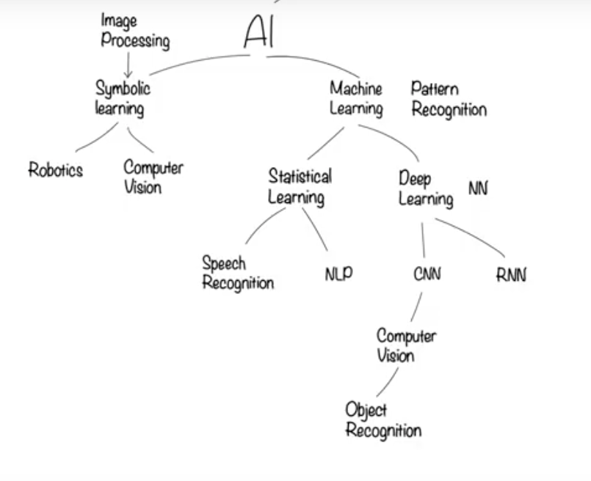

Slide 12
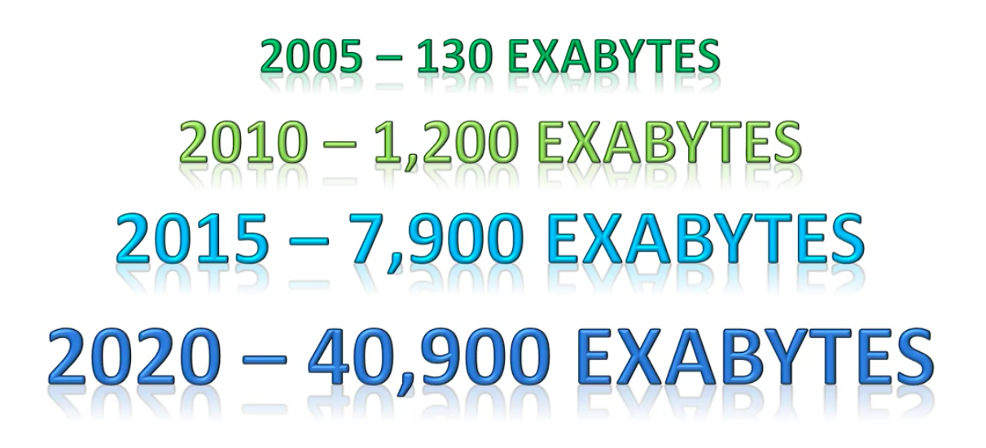
Data

Slide 13
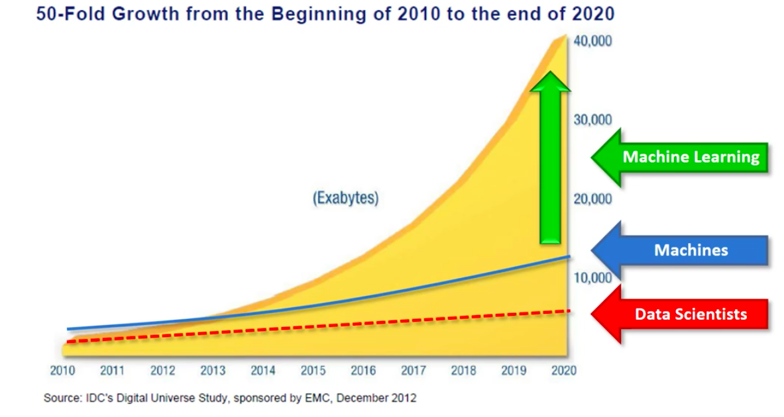
Machine Learning

Slide 14
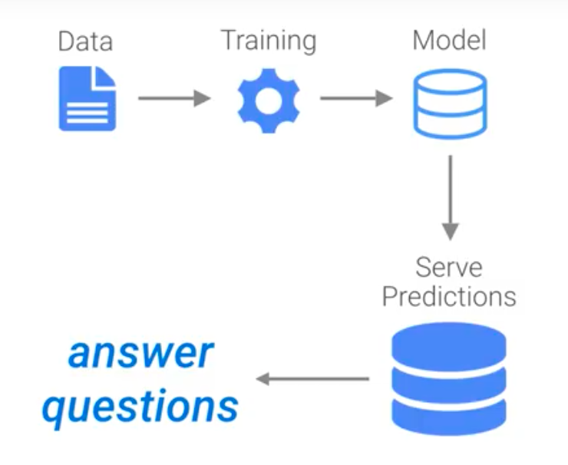
Machine Learning (continued)

Slide 15
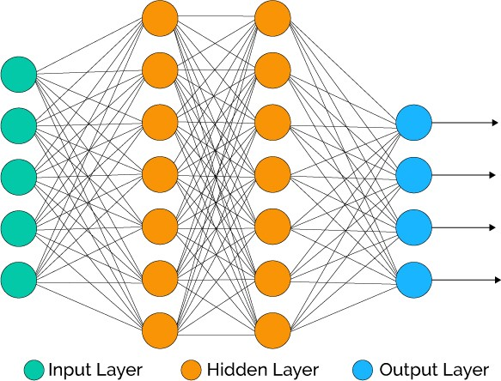
Neural Networks

Slide 16
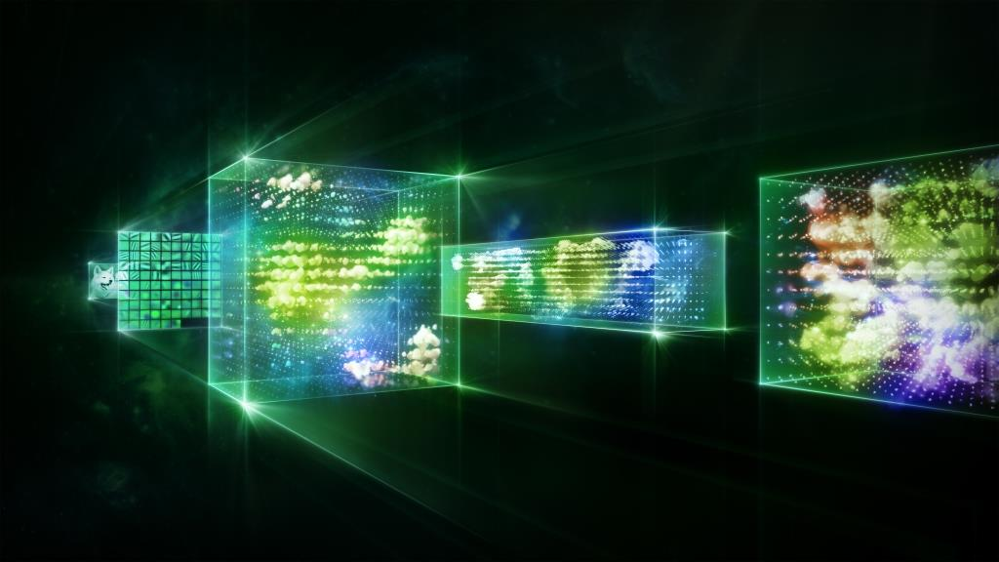
Convolutional Neural Networks
CNN uses 3 main concepts:
Local Receptive fields
Weights and Biases
Activation and Pooling

Slide 17
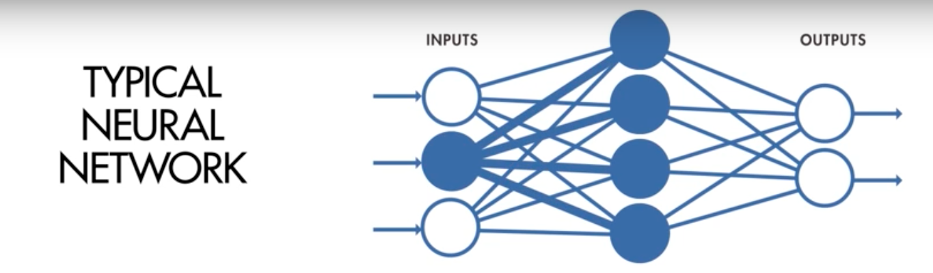
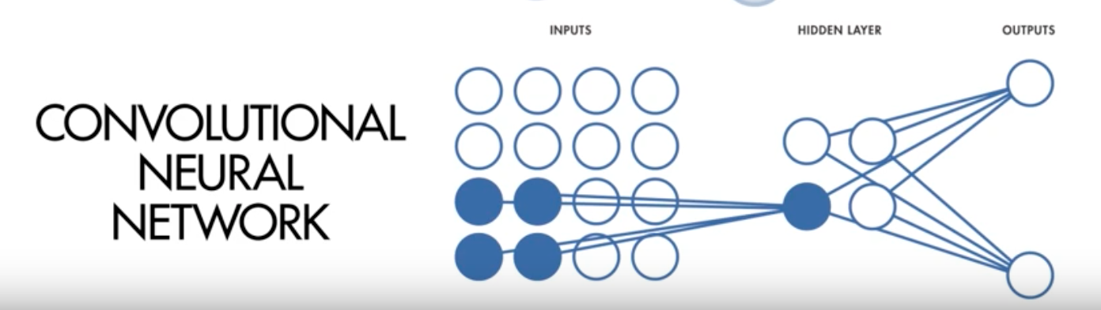

Slide 18
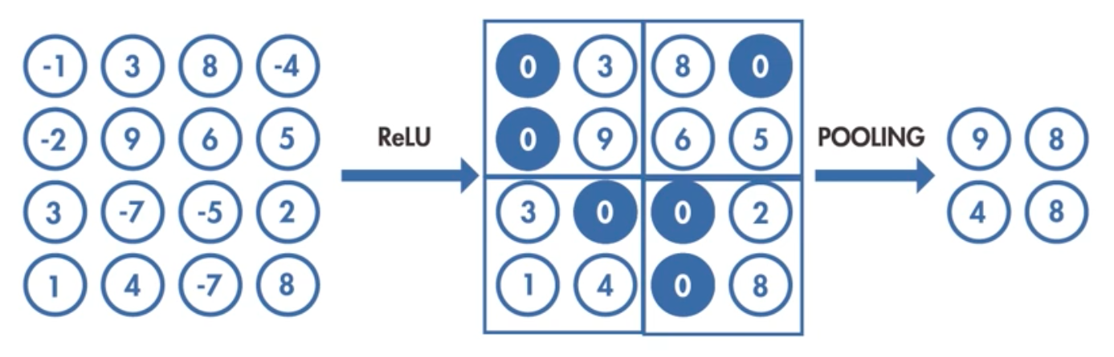

Slide 19
Softmax function
The softmax function or normalized exponential function is a generalization of the logistic function. It uses the logistic regression algorithm.
It is often used in the final layer of a CNN.
Softmax produces multiple outputs for an input array. The sum of the softmax outputs is always equal to 1.

Slide 20
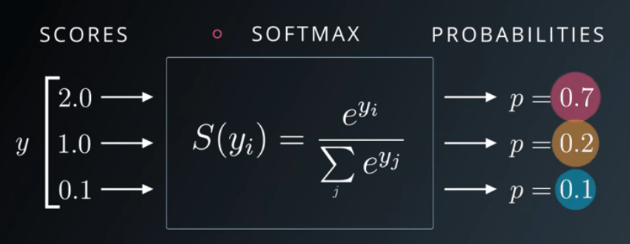
Softmax function (continued)
σ(x₁) = e^{x1} / (e^{x1}+e^{x2}+e^{x3}) = e² / (e² + e¹+ e^{0.1}) = 0.7
σ(x₂) = e^{x2} / (e^{x1}+e^{x2}+e^{x3}) = e¹ / (e² + e¹+ e^{0.1}) = 0.2
σ(x₃) = e^{x3} / (e^{x1}+e^{x2}+e^{x3}) = e^{0.1} / (e² + e¹+ e^{0.1}) = 0.1
As seen, inputs normalized between [0, 1]. Also, sum of the results are equal to 0.7 + 0.2 + 0.1 = 1.

Slide 21
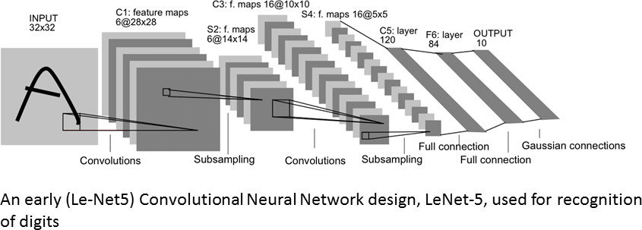
Implementation

Slide 22
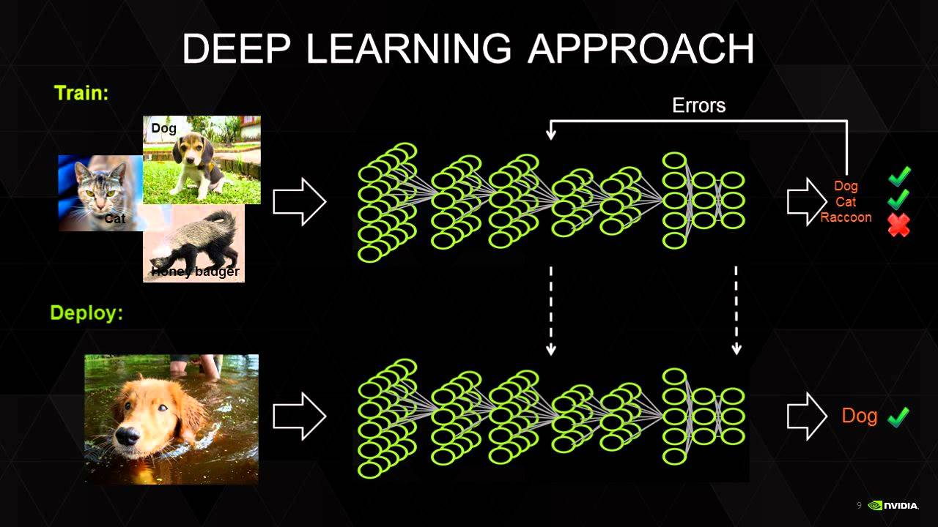
Backpropagation

Slide 23
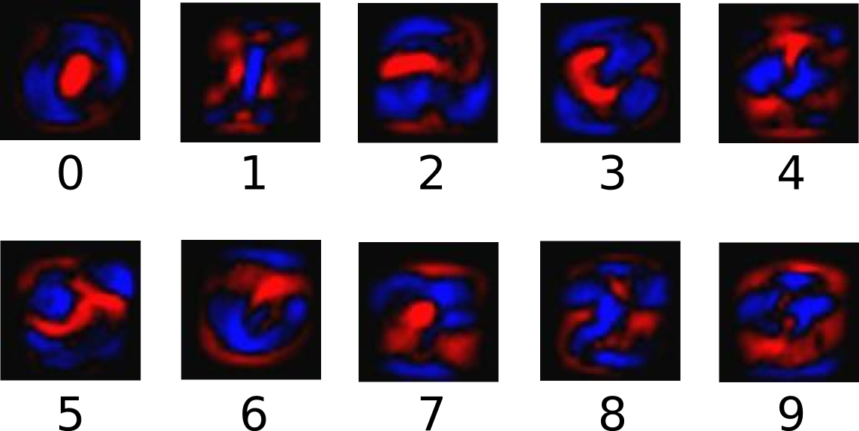
The following diagram shows the weights learnt by a model:

Slide 24
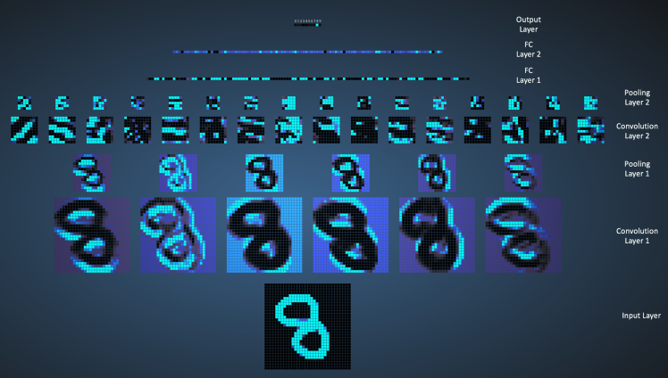

Slide 25
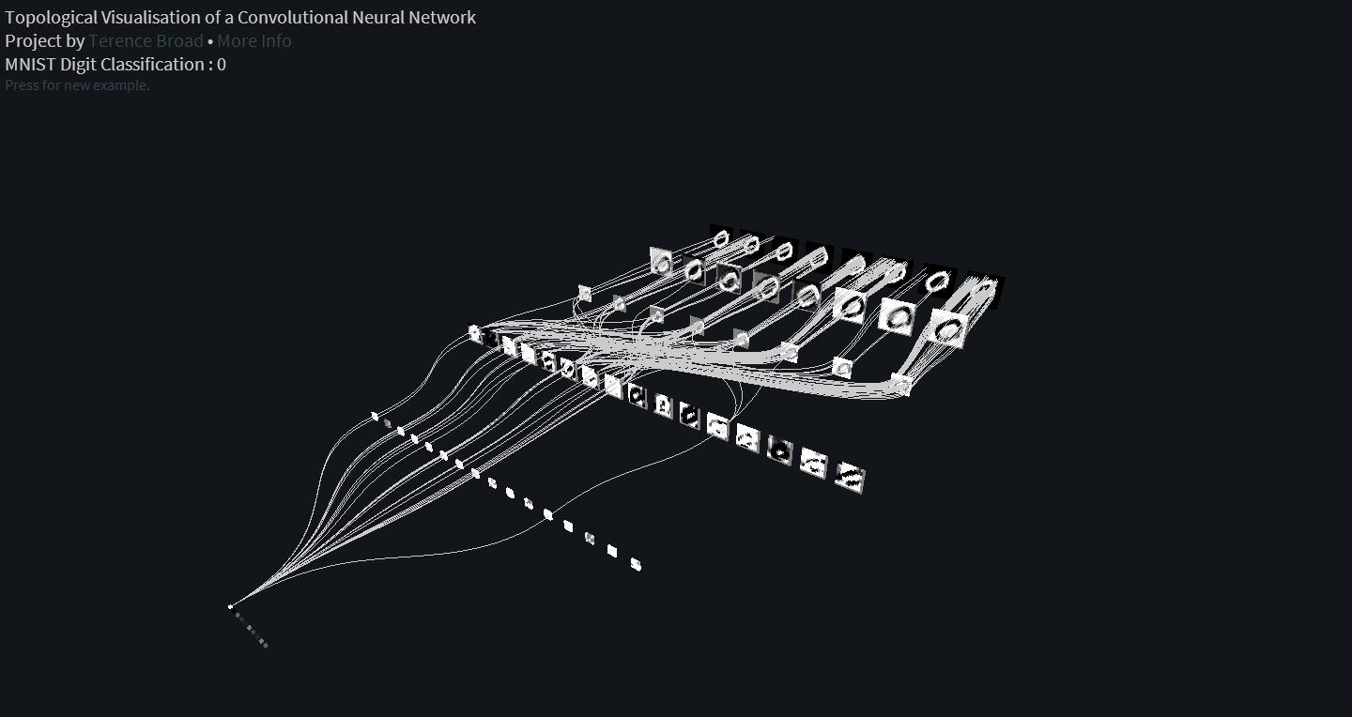

Slide 26
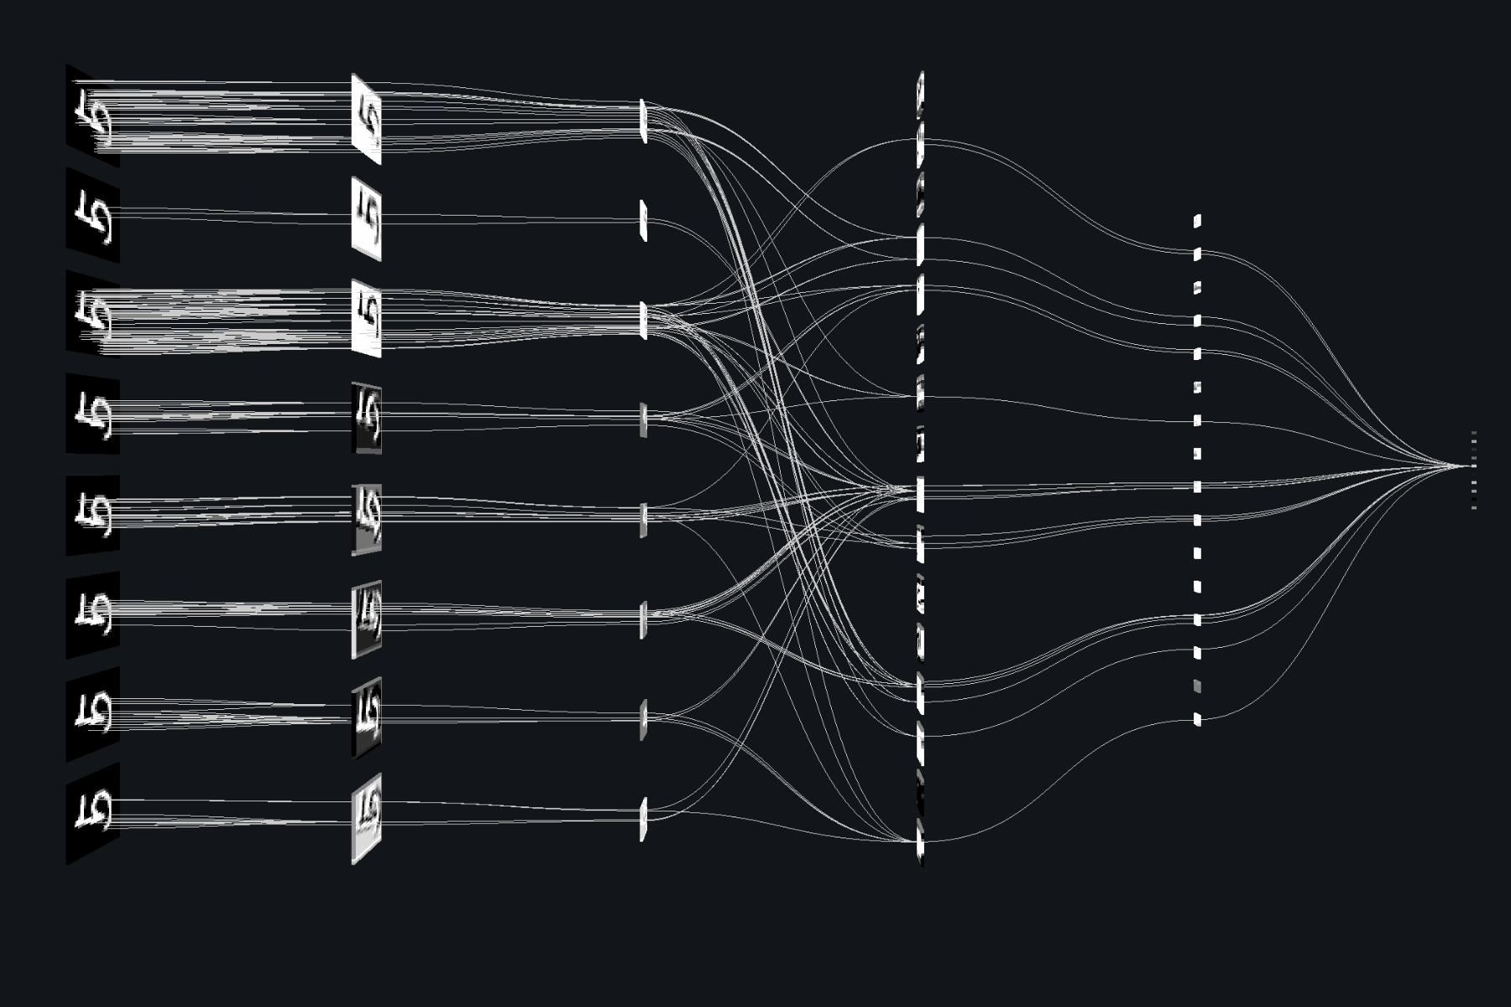

Slide 27
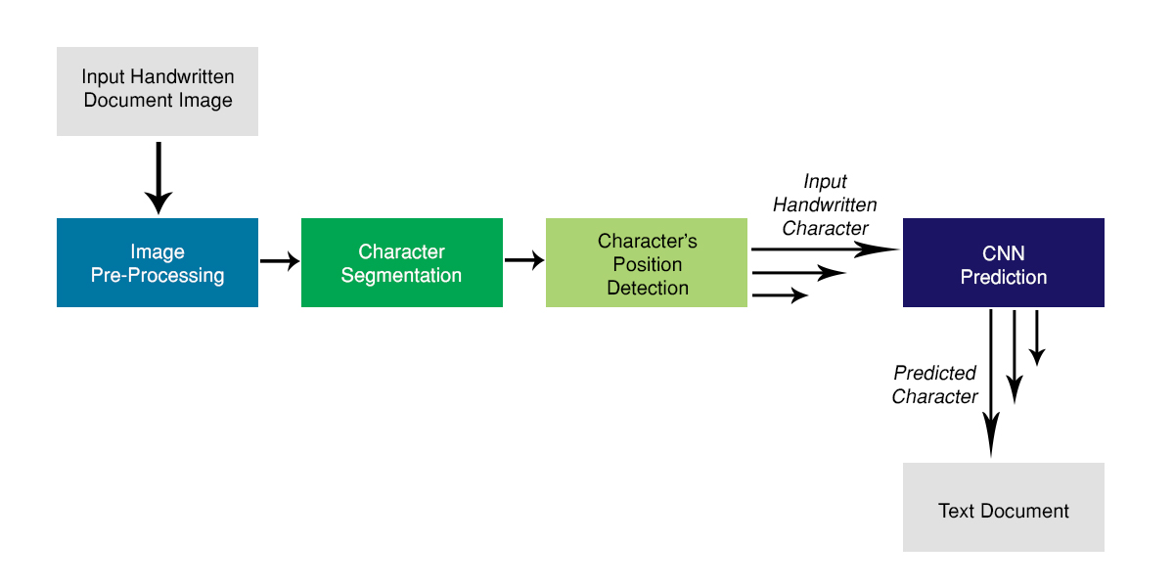
Overall System Architecture

Slide 28
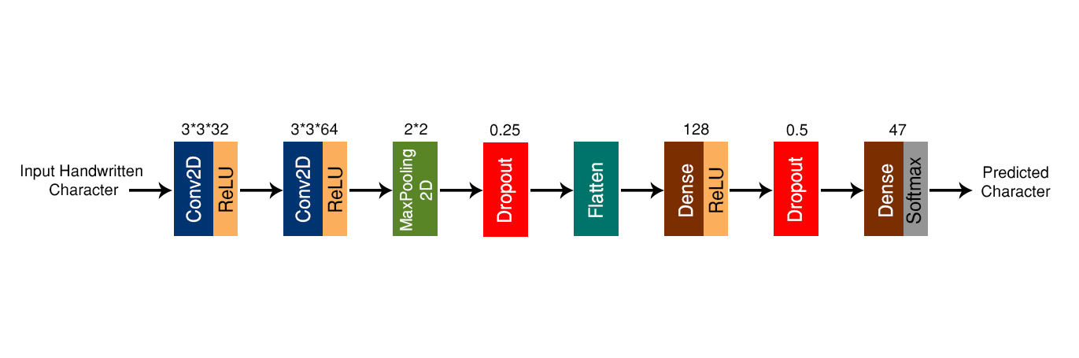
CNN Model

Slide 29
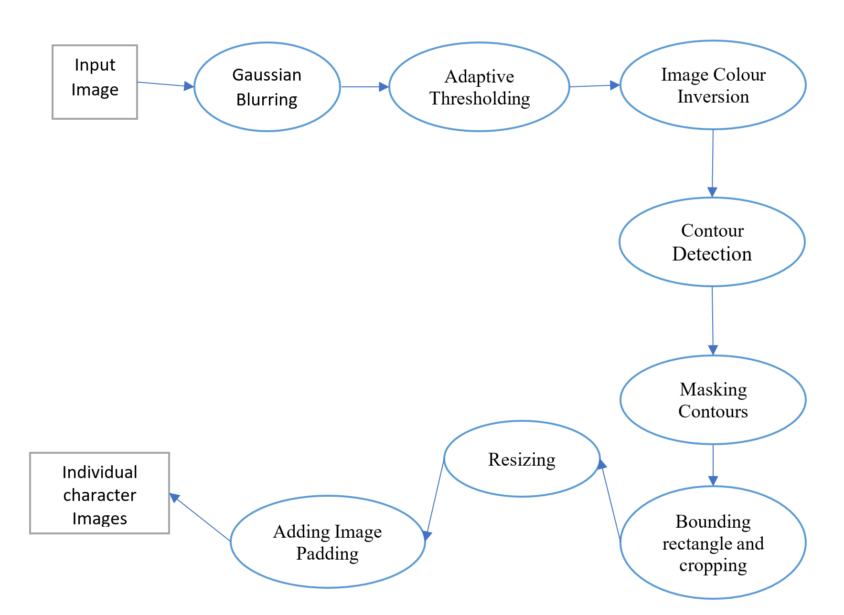
Image Processing and Character Recognition

Slide 30
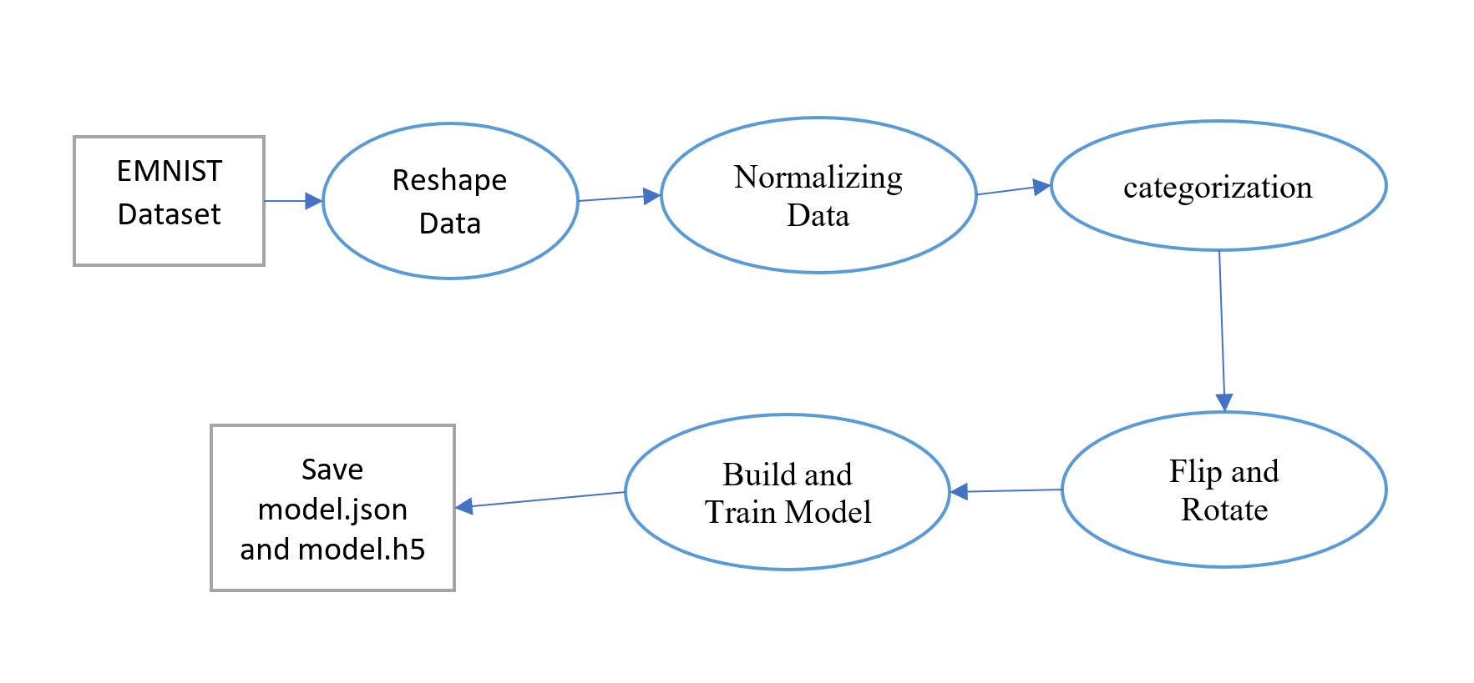
Building CNN Model

Slide 31
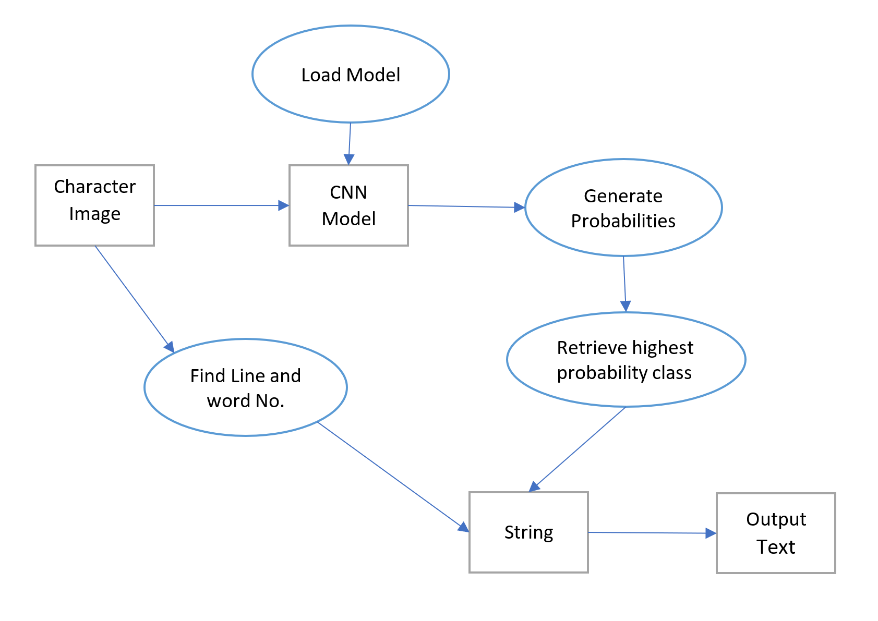
Character Prediction

Slide 32
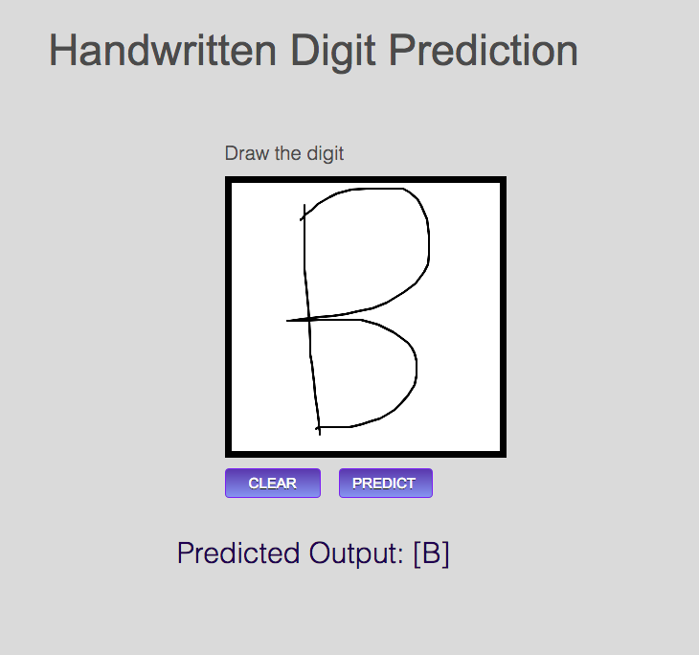
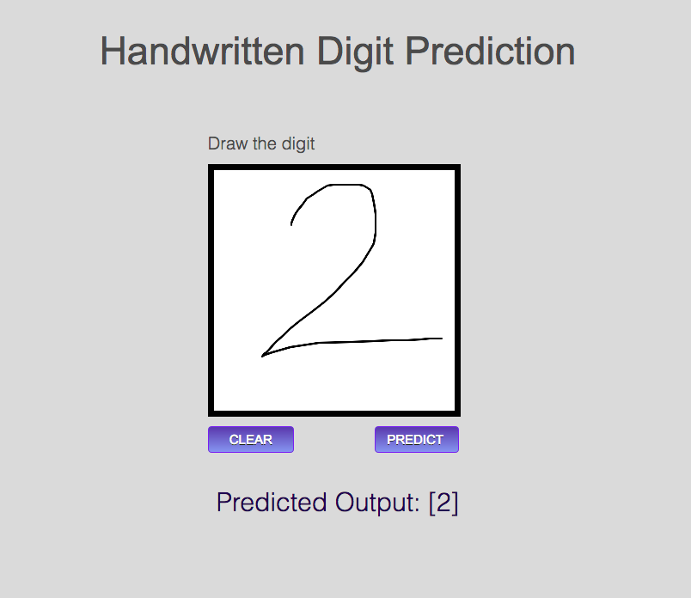
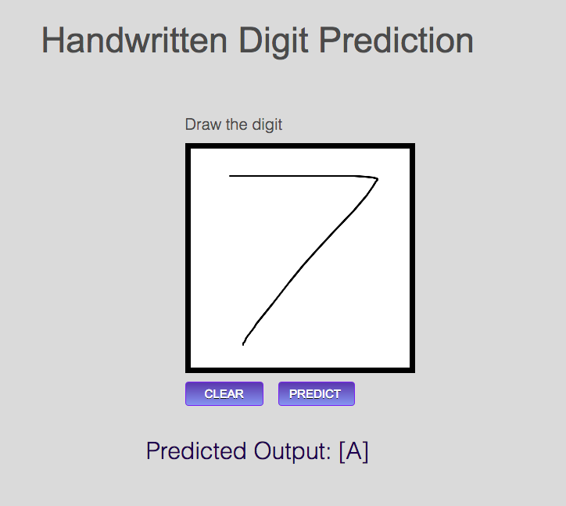
Some Test Results

Slide 33
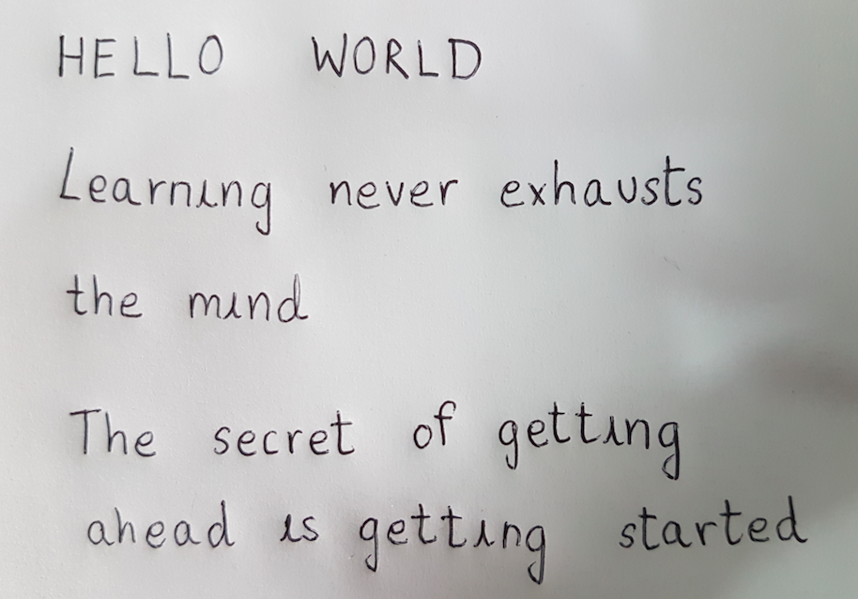
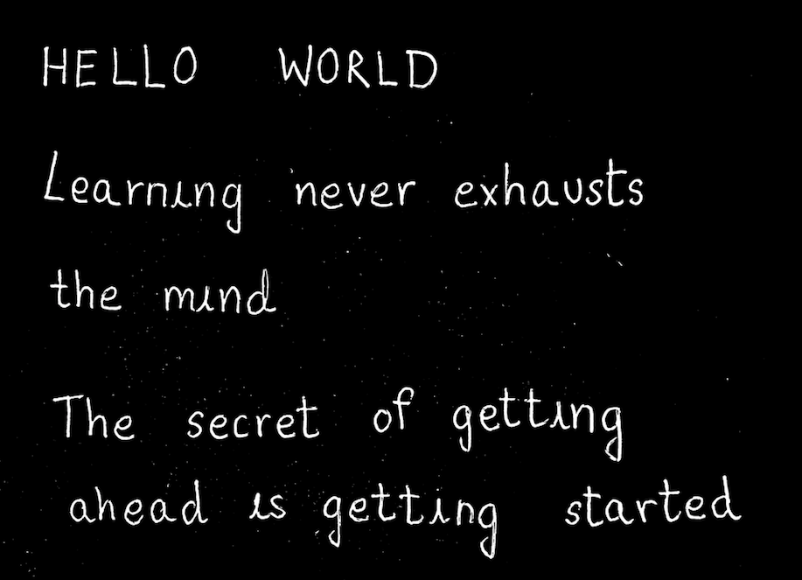

Slide 34
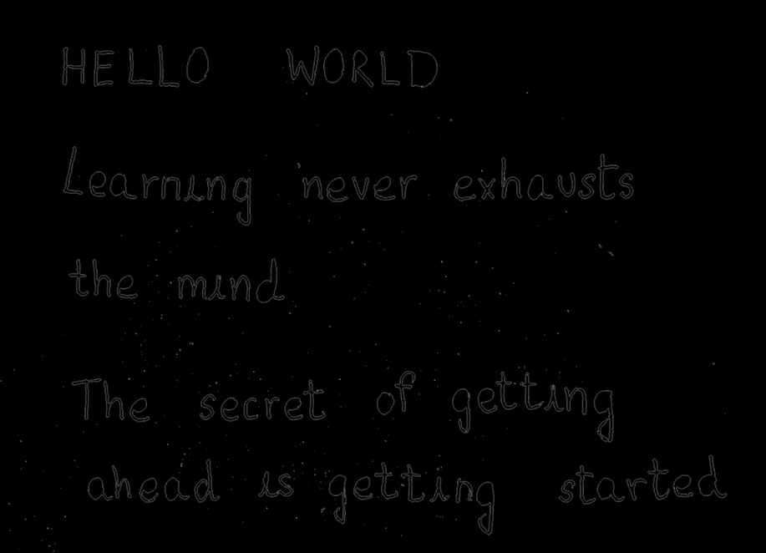
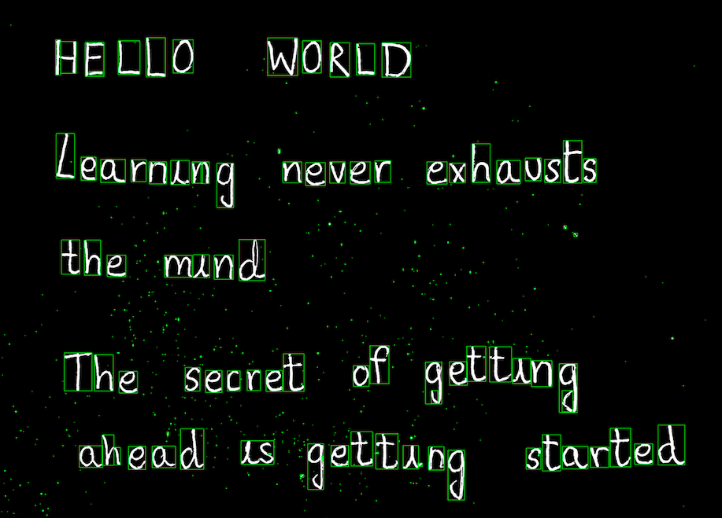

Slide 35
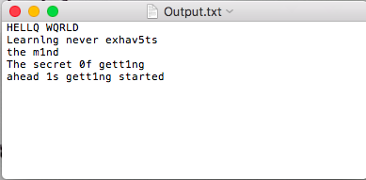

Slide 36
System Requirements
Operating System - Windows 10(preferred)
Processor - Intel i7
Speed - 3.0 GHz
RAM - 16 GB (min)
Hard Disk - 100 GB
Programming Language - Python
Graphic card NVidia with CUBA Support
Anaconda IDE
Tensor Flow
Nvidia cuDNN API
EMNIST Dataset

Slide 37
Individual Contribution
Name | Individual Programming Responsibility
Mohan Krishna B | Image Processing and Character segmentation using OpenCV.
Swathi Madhavan | Machine Learning and neural networks for creating the model.
Prakash H | Classifying the words and lines from the input document and retrieving their positions.
Rahul N

Slide 38
Conclusion
In this project, a Machine learning Neural Network model was developed, which converts the handwritten text document to digital document consisting of ASCII characters.
The input image was pre-processed in order to remove the noise and artifacts in the image.

Slide 39
Future Enhancements
Different datasets
Implementing Back-Propagation after deployment
Using Natural Language Processing (NLP)

Slide 40
THANK YOU
By :
Mohan Krishna B(1NH14CS071)
Swathi Madhavan(1NH14CS732)
Prakash H (1NH14CS167)
Rahul N (1NH14CS098)

